Slide 1
Please Enter Password…
*********
Confirming Identity…
Identity Confirmed. Welcome Group 07
Your mission, should you choose to accept…
Design and integrate a system which meets the following criteria:
I. Unmanned Aerial Vehicle (UAV)
II. UAV User Control Terminal
III. UAV All Terrain Carrier
IV. UAV All Terrain Carrier User Control Terminal
V. XXXXXX
Notes:
Joe

Slide 2
Do you chose to accept this mission?
Yes
No

Slide 3
Congratulations. Your mission codename is:
DRONENET: The Quad Chronicles
You will be reporting to:
Dr. Sam Richie, UCF, EECS, Electron Wizard
A team of 4 has been put together for you consisting of:
Brandon “Ironbit” Frazer, E.E.
Specialty: Electronics, Embedded Software, and Hacking
Raymond “A.R.M.Y.” Lueg, E.E.
Specialty: Electronics, Power Systems, and Mechanics
Ryan “MC Melter” Borden, E.E.
Specialty: Electronics, Communications, and Integration
Joe “Cobra” Howard, E.E.
Specialty: Surveillance, Computer Systems, and Deception

Slide 4
This message will self destruct in:
3…2…1
…

Slide 5
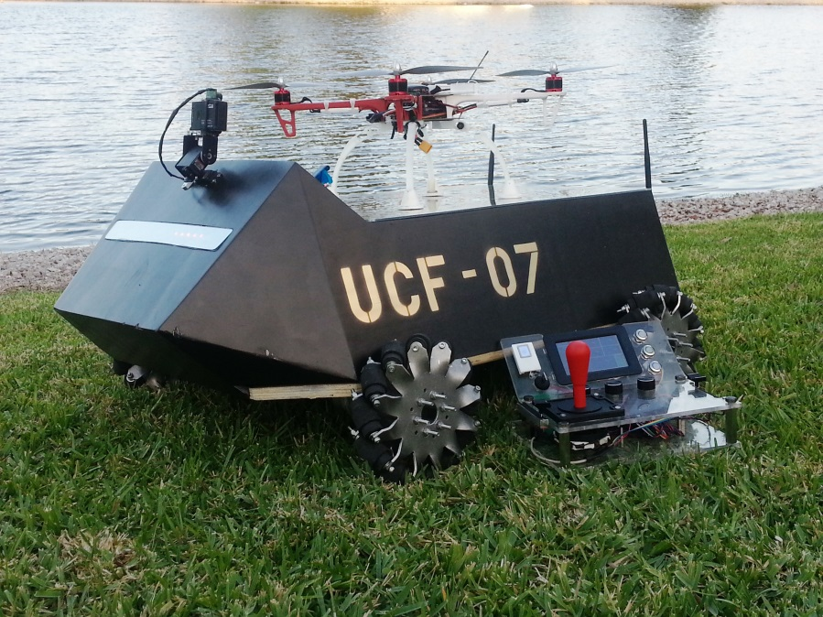
DRONENET: The Quad Chronicles
Brandon Frazer
Raymond Lueg
Joe Howard
Ryan Borden

Slide 6
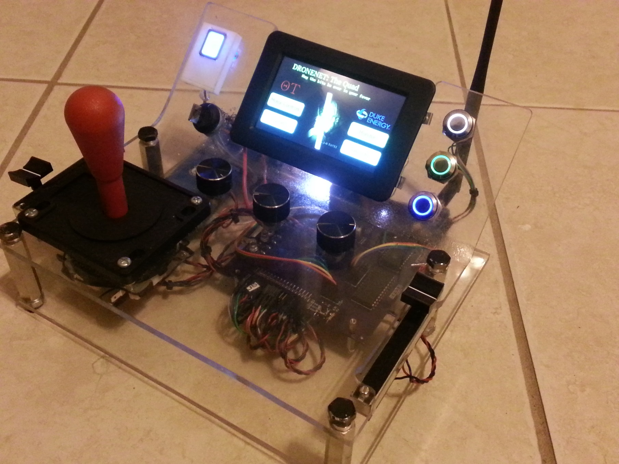
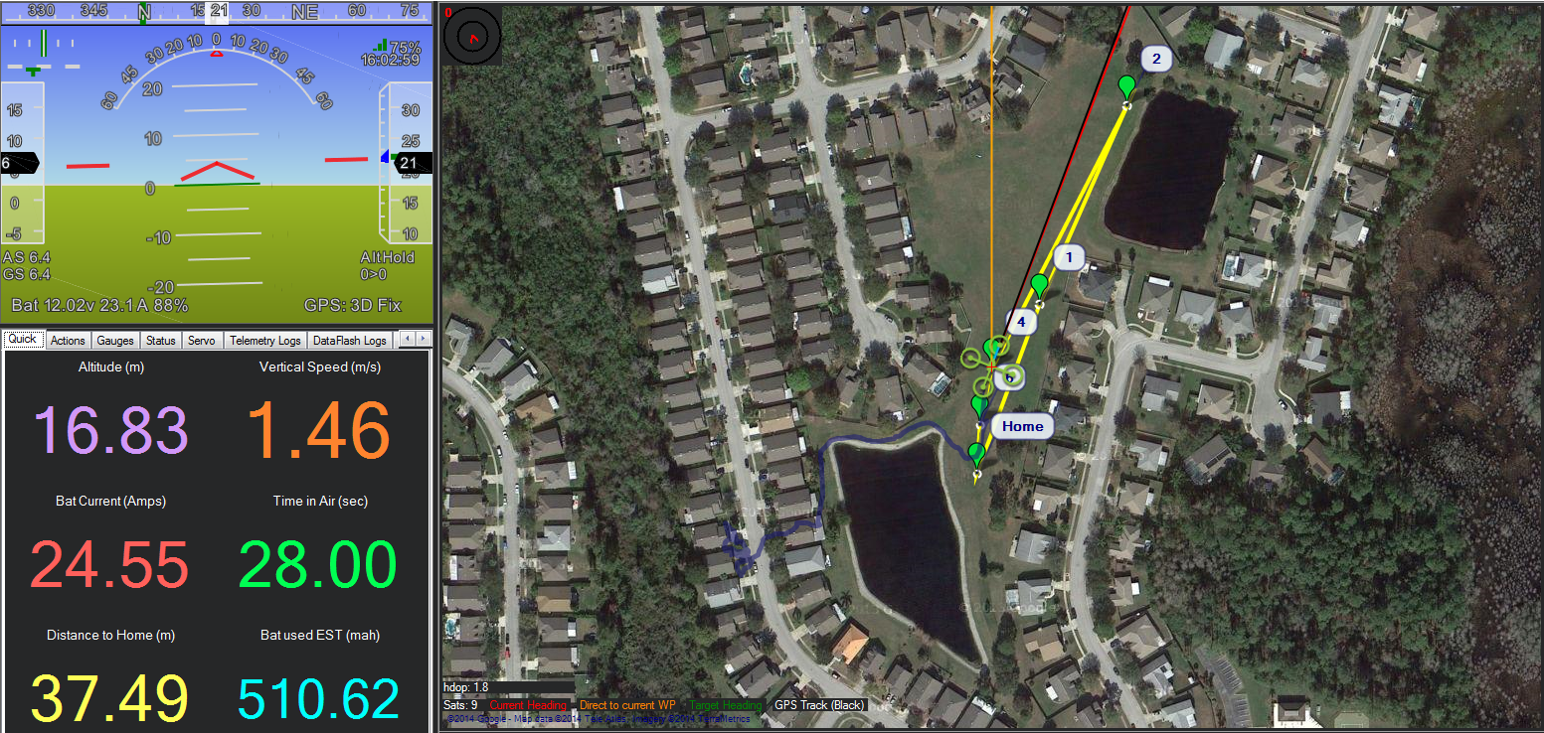
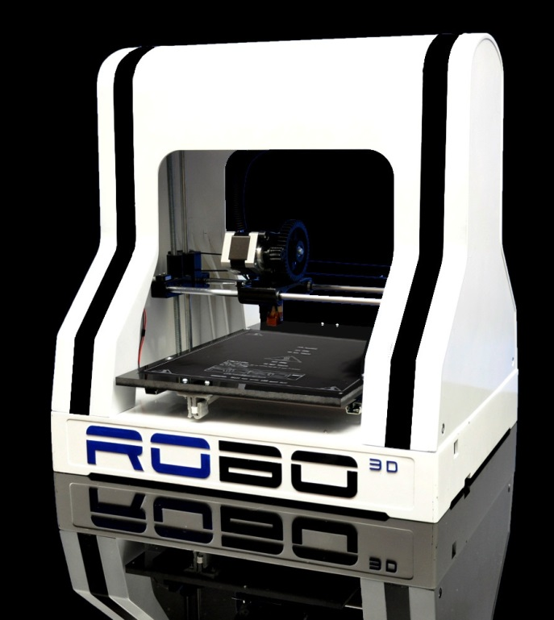
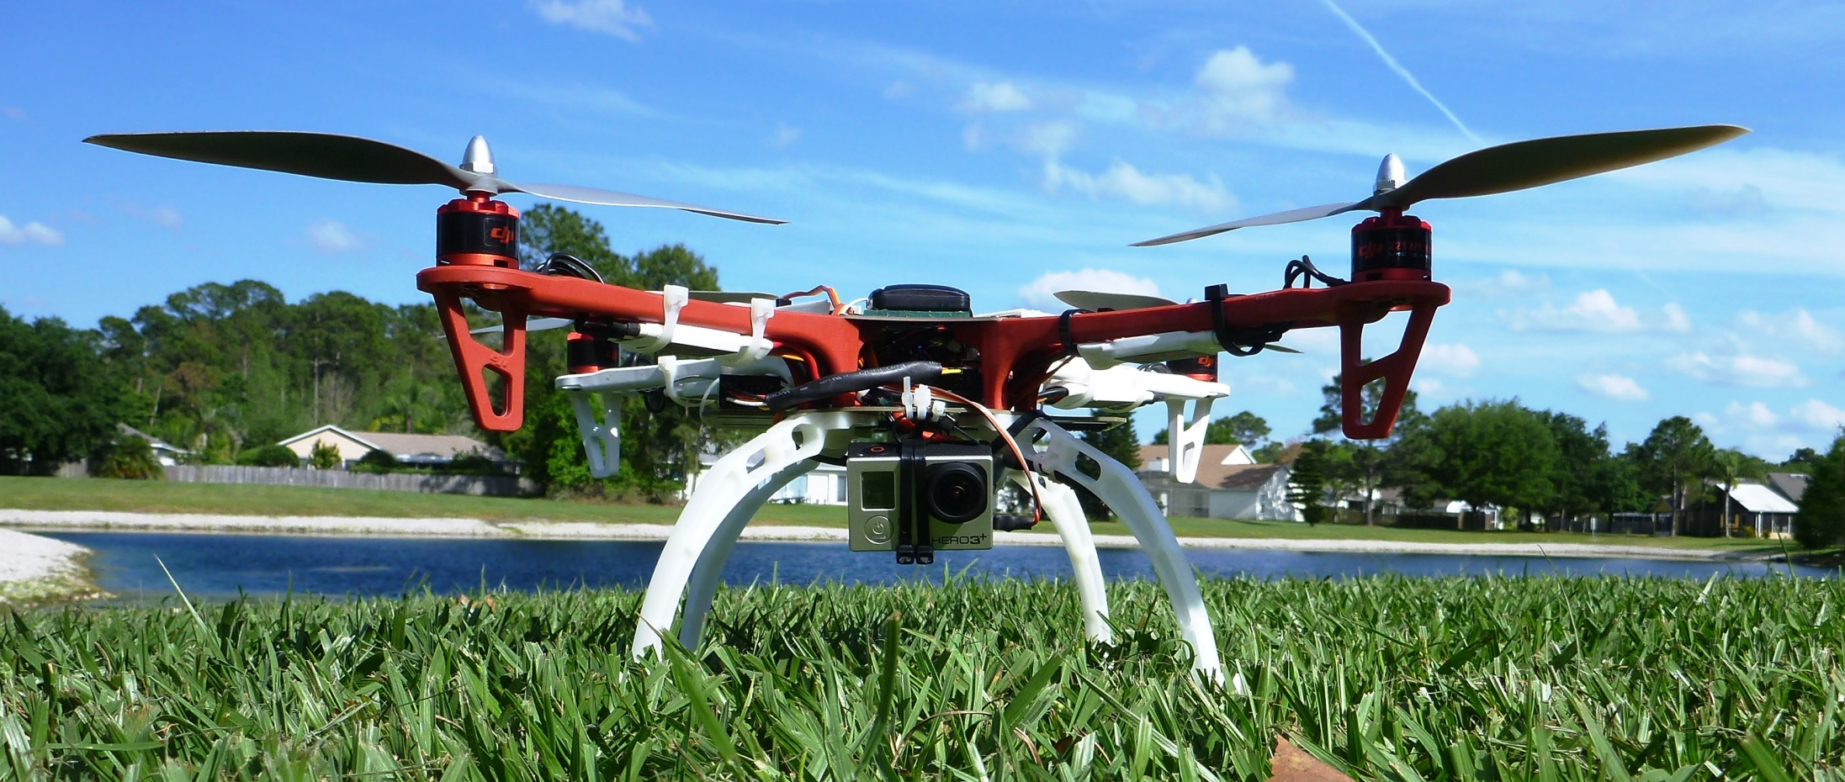
DRONENET:THE QUAD CHRONICLES Design & System Integration
Joe Howard
What system did we design & integrate?
Four major subsystems that are integrated with one another
Unmanned Aerial Vehicle (UAV)
UAV Control Terminal
UAV Carrier
UAV Carrier Control Terminal
XXXXXXXXXXXX
Why are we doing this?
Challenging, interesting, and FUN
Real world applications
Allows us to utilize two 3D printers
Notes:
“Integrating parts”
Picture animation for each main part
Video of 3D printing
Design and System integration

Slide 7
DRONENET:THE QUAD CHRONICLES Design & System Integration 3D Printers (Additive Manufacturing)
Joe Howard
Notes:
“Integrating parts”
Video of 3D printing
Design and System integration

Slide 8
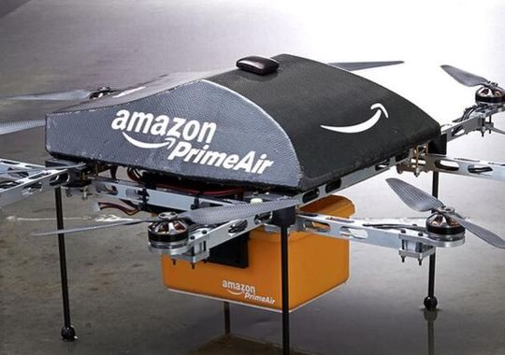
DRONENET:THE QUAD CHRONICLES Design & System Integration
Brandon Frazer
Real World Applications
Military Intelligence
Computer Vision capabilities
Surveillance
Search and rescue assistance
Package/ Pizza delivery

Slide 9
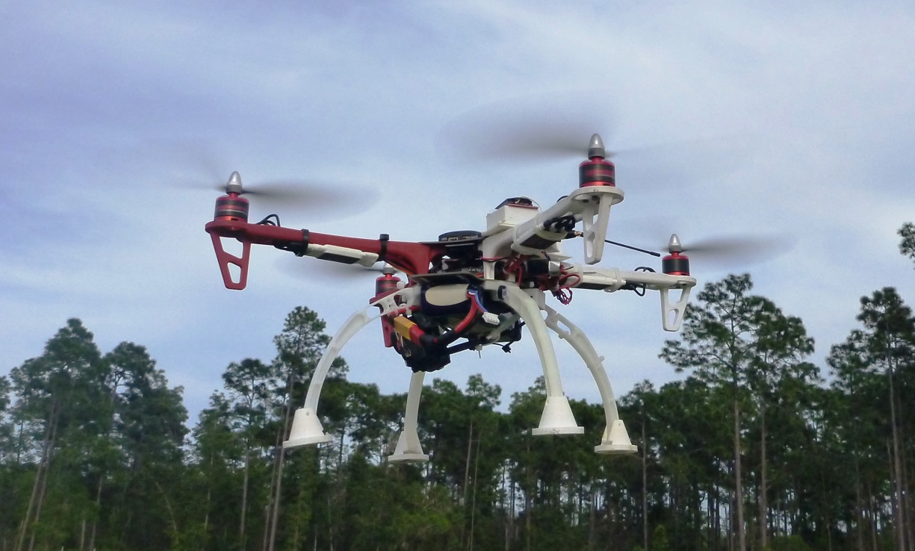
THE QUAD CHRONICLES: UAV Design & System Integration
Ryan Borden
Quadcopter - UAV
Autonomous flying modes and landing feature
Flies within FAA guidelines
Sends flight data wirelessly to the quadcopter terminal
Sends video data using a GoPro Hero 3
Notes:
Tie back to first part
I
Can fly up to FAA circulars +

Slide 10
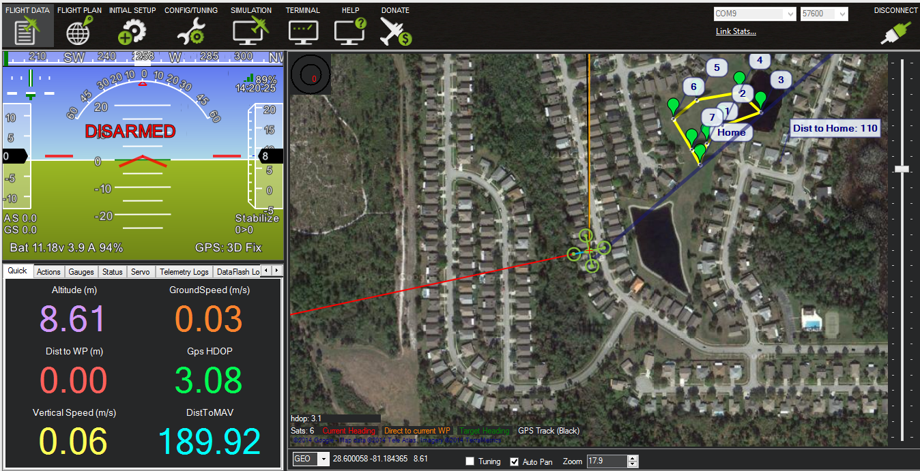
THE QUAD CHRONICLES: UAV Control System Design & System Integration
Ryan Borden
Quadcopter Control Terminal
Preplanned waypoint missions
Brains of the UAV system
Can wirelessly view real-time data
Battery life
GPS
Altitude
Notes:
Change to II
Keeps in required alititude
The 1 of 2 brains and controls of the UAV system

Slide 11
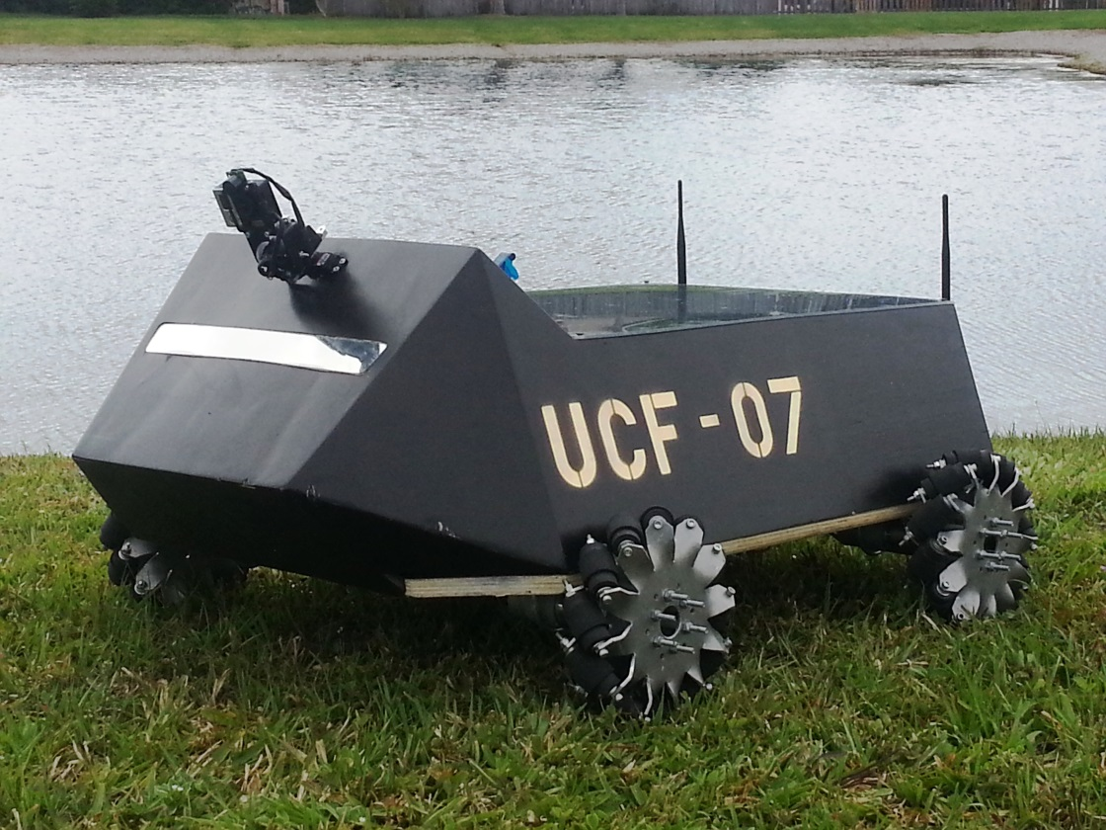
THE QUAD CHRONICLES: UAV Carrier Design & System Integration
Raymond Lueg
UAV Carrier
All terrain
Houses renewable power system
Landing and locking system
Notes:
Change title/heading
III
Holds renewable power system, landing and locking platform, all terrain,

Slide 12
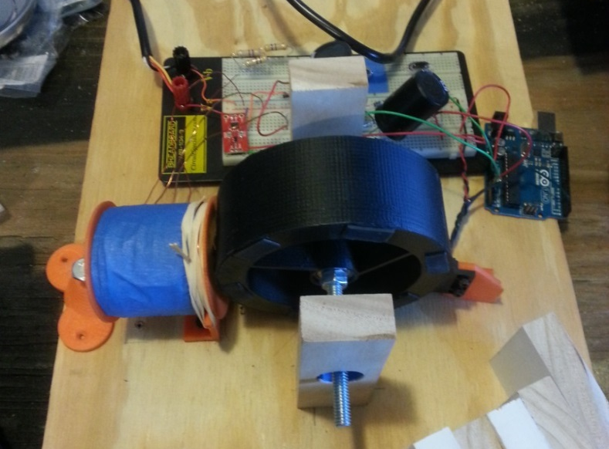
Raymond Lueg
THE QUAD CHRONICLES: UAV Carrier Design & System Integration
UAV Carrier Cont. – Bedini Motor
Regenerative System
4, 12 volt batteries
Solar panel for supplemental power
Charges batteries by injecting voltage instead of current
Less heat
Longer battery life
Notes:
III Continued…

Slide 13
THE QUAD CHRONICLES: UAV Carrier Control Terminal Design & System Integration
Brandon Frazer
UAV Carrier Control Terminal
Mobile Platform Brains
Real time monitoring and controls
Self Contained
Notes:
IV: Design and…
Mobile Platform Brains and Controls 2 of 2
Real time monitoring and controls
Self contained
If one fails, then the other one can still run

Slide 14
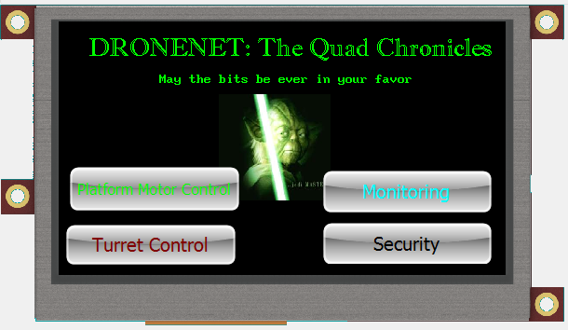
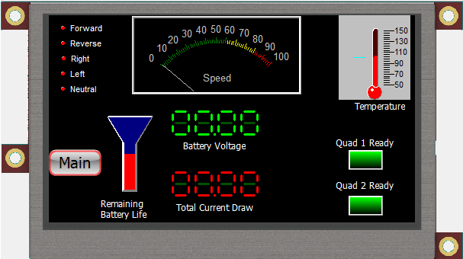
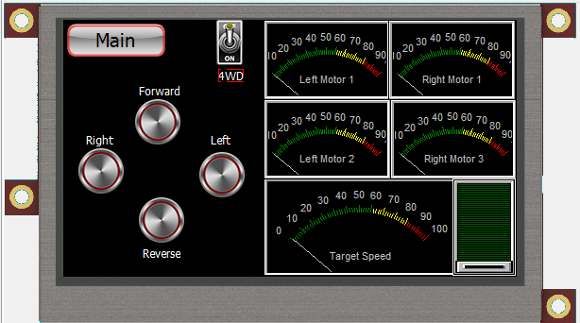
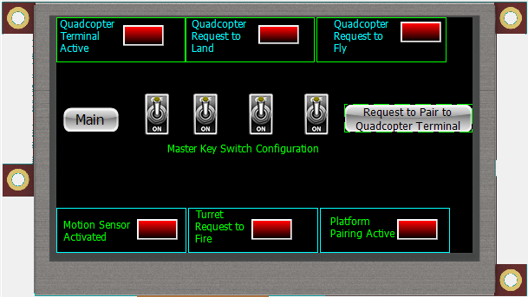
THE QUAD CHRONICLES: UAV Carrier Control Terminal Design & System Integration
Brandon Frazer
Notes:
IV: Mobile Platform Control contd…

Slide 15
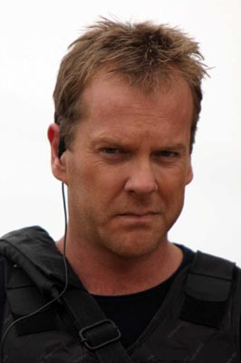
THE QUAD CHRONICLES UAV Carrier Control Terminal Design & System Integration
Brandon Frazer
UAV Carrier Control Terminal Continued – System Security
Secured across Sub-Systems I-IV
Fingerprint scanner for user authentication
Certain actions (such as arming the turret or unlocking/landing a quadcopter) require authentication codes
Notes:
IV: contd….
Secured Systems – Across all Sub-Systems I-IV
Add Sound

Slide 16
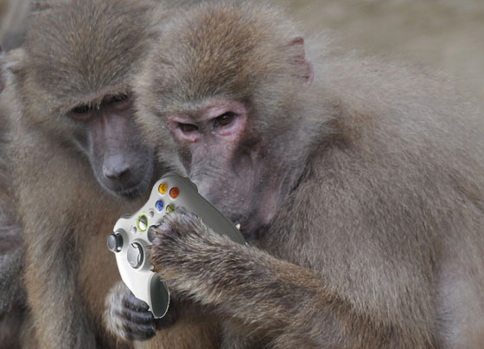
THE FIFTH ELEMENT Design & System Integration
Brandon Frazer
Human operation
Not fully autonomous
Someone has to “Push the button”

Slide 17
Acknowledgments
Brandon Frazer
Dr. Richie – Encouragement and Advice
Duke Energy – Funding
Theta Tau Rho Gamma
Monica Bertram, M.E.
Sean DelVecchio, M.E.
Matthew Harrison, M.E.
Steven Darrow, A.E.
UCF Alumni
Stephen Sheldon, E.E.
Come visit our booth outside of HEC

Slide 18
THE QUAD CHRONICLES Bloopers Design & System Integration
Brandon Frazer
Notes:
IV: contd….
Secured Systems – Across all Sub-Systems I-IV
Add Sound

